Slide 1
Jarir Bookstore App
Students:
Mohammed Khalid Al-Dawood 442051602
Mustafa Mahmoud Numan 441051712
Saleh Ibrahim Alqubayshi 442051125

Slide 2
1-1.Introduction:
Jarir Bookstore is a popular retail chain in the Middle East that offers a wide range of products, including books, electronics, and office supplies. The Jarir Bookstore mobile app is an essential tool for the company as it allows customers to browse and purchase products from their mobile devices.

Slide 3
1-2.Problem:
The problem on which the Jarir Bookstore application was developed is that in the past, if the customer wanted to buy a specific commodity or product, he must go to the store himself and search for the availability of this product, and this causes trouble, whether it is moving between stores or wasting time, and also there is difficulty in comparing products, whether at prices or specifications, and knowing what is new.

Slide 4
1-3.Background:
Jarir Bookstore is a well-established brand with a loyal customer base in the Middle East. However, the company may face competition from online retailers and e-book platforms. Developing a mobile application can help Jarir Bookstore stay competitive and provide a modern, convenient shopping experience for customers.

Slide 5
1-4.Proposed Solution:
Based on these problems, Jarir application has been developed to be a pioneering and distinctive application that combines several products, including electronic products, books and a lot, and what is presented is that the customer can browse many categories of products and order them online and deliver them to the customer's home, thus saving time and effort for the customer and also in the field of product marketing for companies.

Slide 6
1-5.Workplan:
Project Kickoff Meeting
Project Proposal
Feasibility Study & Project Proposal Report
Finalize Project Plan
Project Kickoff
Feasibility Study

Slide 7
2.Project requirements: 2-1. Functional Requirements:
1. User Authentication: Jarir Application must provide a secure and reliable user authentication process to protect customer information.
2. Browse and search for products: Jarir Application should allow users to browse products efficiently by category or keyword research.
3. Add to cart and buy: Jarir Application should enable seamless transactions by allowing users to add items to their cart, view their cart, and complete purchases safely and easily.
4. Order Tracking: Jarir Application must provide real-time tracking information for all orders.
5. Personalization: The Jarir Application should enable users to personalize their shopping experience by providing product recommendations based on search history and purchase behavior.
6. Send notifications: Jarir Application must allow push notifications to alert users of offers, promotions and order updates.
7. Customer Support: Jarir App should provide users with comprehensive customer support through chat or phone for inquiries, complaints and returns.
8. Multi-Platform Compatibility: The Amazon App must be accessible across multiple platforms, including iOS and Android devices.

Slide 8
2-2. Non-Functional Requirements:
1. Reliability: The Jarir App should function reliably and consistently without any crashes or downtime, to ensure a seamless user experience.
2. Performance: The Jarir App must perform efficiently, with fast loading times and quick responses to user actions.
3. Usability: The Jarir App must have a user-friendly interface with easy navigation and clear instructions for all features and functions.
4. Security: The Jarir App must ensure the safety and security of user data, including personal information, payment details, and order history.
5. Portability: The Jarir App should be readily available and accessible across multiple devices and platforms, including smartphones, tablets, and desktop computers.

Slide 9
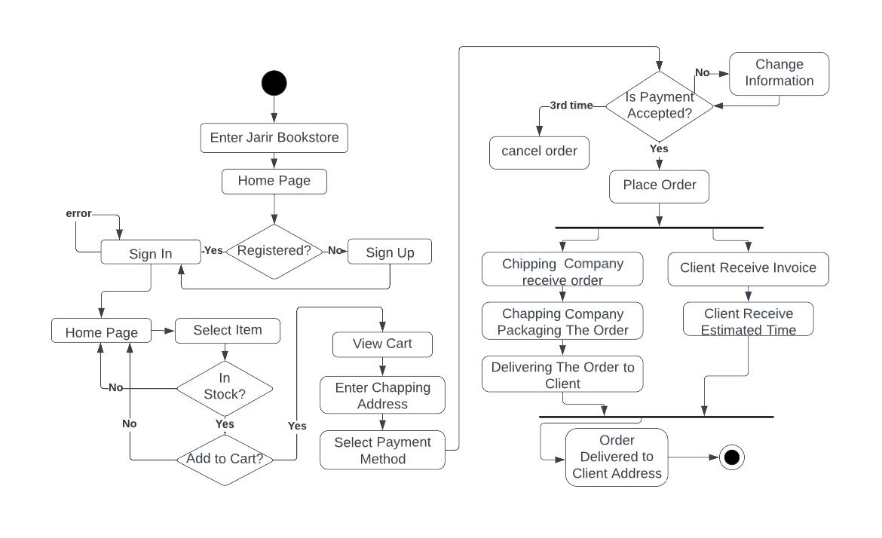
3.Activity diagram:

Slide 10
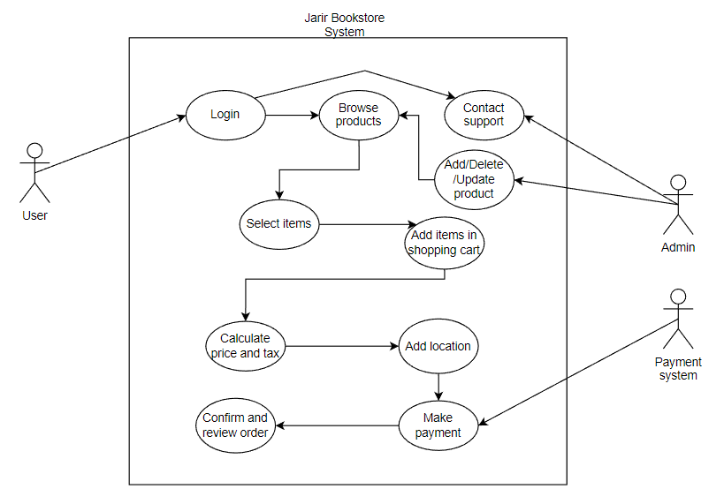
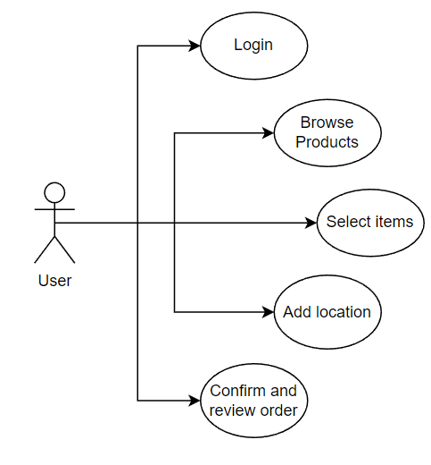
4.Project Use Case Modelling:
Diagram:
Actors:
Customer, Admin, Jarir bookstore system, Payment system .
Use cases &its related use cases:

Slide 11
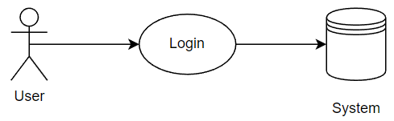
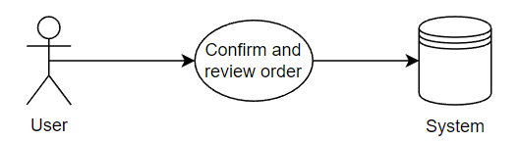
Table 1:
Table 2:
Jarir bookstore: Login
Actors | User, System
Description | The user logs in by e-mail and password previously registered in the system.
Data | E-mail and password.
Stimulus | User Request Login in Jarir App.
Response | The system determines whether the information is correct or not to access the account.
Comments | For security, the system allows 3 login attempts.
Jarir bookstore: Confirm and review order
Actors | User, System.
Description | The user confirms the order and then requests a review from the system.
Data | Order, which consists of the products to be purchased.
Stimulus | The user wants to pay to confirm the order and delivery of the ordered products.
Response | The system determines based on whether the products are available and whether the required amount has been paid to accept the order or not.
Comments | Inform the user of the current policies of the application and the system's commitment to send an email to the user with the required information.

Slide 12
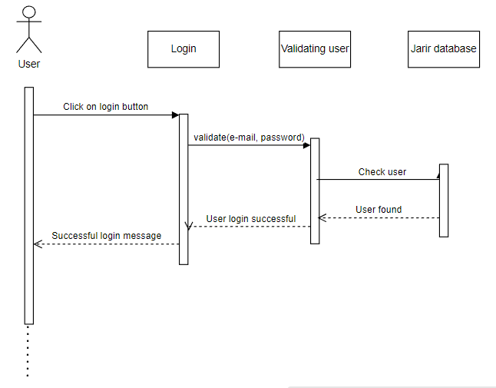
5.Creating Sequence Diagrams:
Sequence diagram for login
to Jarir bookstore application:

Slide 13
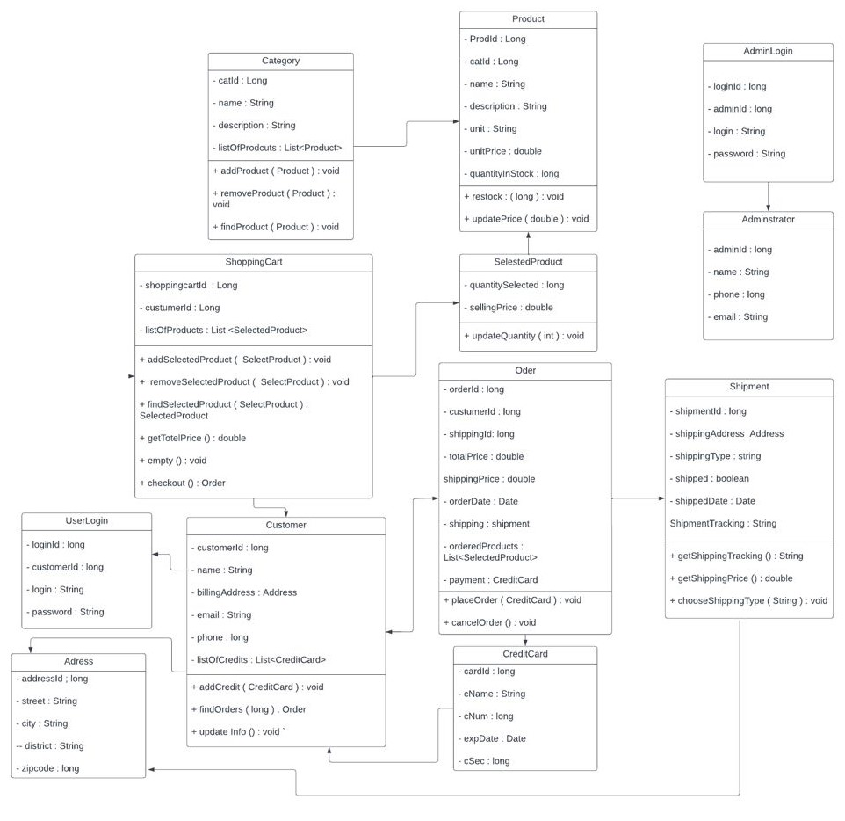
6.Creating a Class Diagram:

Slide 14
Conclusion
the Jarir Bookstore mobile app will provide a modern and convenient shopping experience for customers while staying competitive in the market.

